Slide 1
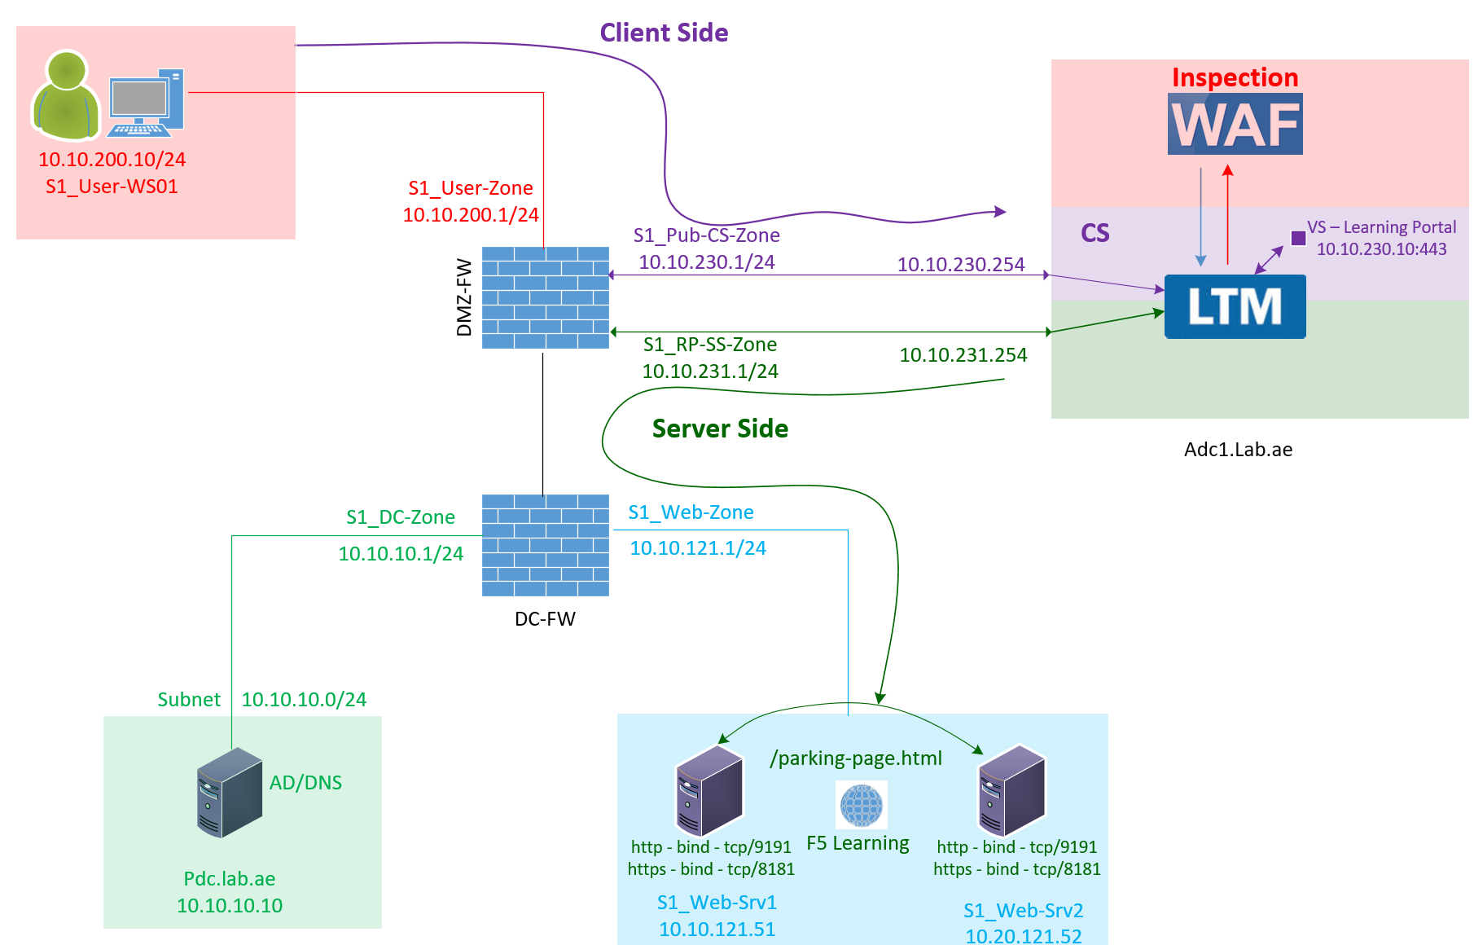

F5 LTM Learning with Alexander S
Bonus Chapter 03 – How to implement F5 LTM as a full reverse proxy

Slide 2
F5 BIG-IP Deployment - Virtual Machine TMOS Version 21
Spin up the F5 Virtual Machine in ESXi/vCenter/VMWare Workstation Player
Understand the Management Plane and Data Plane connectivity.
Log in to the console and set up the IP address, subnet mask, and default gateway.
Log in using the GUI and change the admin password.
Activate the license and provision the LTM and ASM modules.
Create a self-signed certificate matching your IP and hostname for management connectivity.
Configure the hostname, time zone, and root password.
Configure DNS and NTP.
Understand Management Plane and Data Plane routing in F5.
Configure the Data Plane VLAN with the respective interfaces.
Configure the Data Plane routing.
Verify the Management Plane and Data Plane routing.

Slide 3
Step 1. Spin up the F5 Virtual Machine in ESXi/vCenter/VMWare Workstation Player
Download the F5 TMOS OVA from F5 web site
Get into VCenter/Esxi/Workstation player to install this OVA as a new virtual machine
In our Case it is vCenter. Let us install the F5 VM TMOS Version 21 in vCenter environment.
For the specs – Refer the VM
https://my.f5.com/manage/s/article/K14810

Slide 4
Step 2. Understand the Management Plane and Data Plane connectivity
Download the F5 TMOS OVA from F5 web site
Get into VCenter/Esxi/Workstation player to install this OVA as a new virtual machine
In our Case it is vCenter. Let us install the F5 VM TMOS Version 21.
For the specs – Refer the VM
https://my.f5.com/manage/s/article/K14810

Slide 5
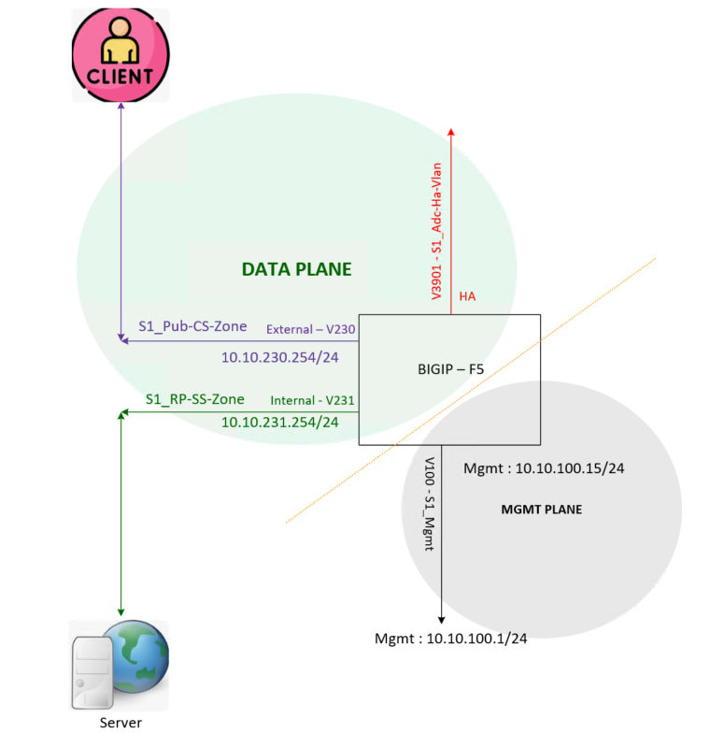
Step 2. Understand the Management Plane and Data Plane connectivity

Slide 6
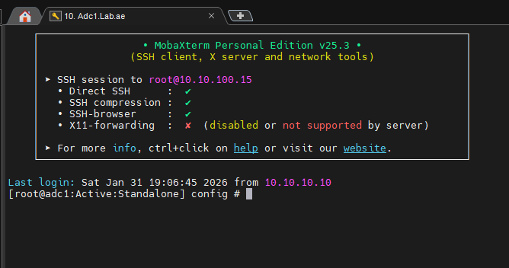
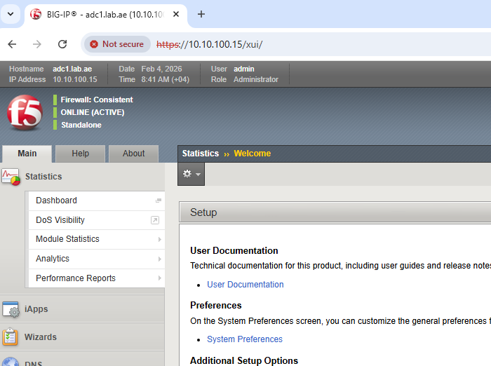
Step 2. Understand the Root Account and Admin Account
Root Account (root):
Provides full, unrestricted access to the underlying Linux operating system (Bash CLI), all configuration files, and system resources.
Admin Account (admin):
Designed for management through the web-based Configuration Utility (GUI) and TMOS Shell (TMSH CLI).
Default Bash access is not available, but it can be enabled if required.

Slide 7
Step 3. Log in to the console and set up the IP address, subnet mask, and default gateway
Type Config to Setup
Management IP : 10.10.100.15
Subnet Mask : 255.255.255.0
Default Gateway : 10.10.100.1

Slide 8
Step 4. Log in using the GUI and change the admin password.
Root account will not work here
We must use admin account for GUI login
During the initial setup, the system sets the admin password to the same value as the root password.
You can log in as admin using the current root password.
Upon first login, you will be prompted to change the password immediately.

Slide 9
Step 5. Activate the license and provision the LTM and ASM modules.
Log in to the F5 website and obtain the trial license key.
Use the trial license key to create a dossier and activate the license.
Provision the LTM, ASM, and APM modules.

Slide 10
Step 6. Create a self-signed certificate matching your IP and hostname for management connectivity
A device certificate is required to enable secure management connectivity.
F5 BIG-IP generates self-signed certificates by default using the built-in OpenSSL libraries included with TMOS.
The email address configured in the certificate should match the certificate’s Common Name (CN).
CN: Adc1.lab.ae
Email: asellapillai@lab.ae
The Subject Alternative Name (SAN) must be configured with both the F5 DNS name and the F5 management IP address using the following syntax:
DNS: adc1.lab.ae, IP: 10.10.100.15

Slide 11
Step 7. Configure the platform settings
Setup the hostname
Adc1.Lab.ae
Setup the time zone
Asia/Dubai
Setup the root password

Slide 12
Step 8. DNS and NTP Configuration
Configure DNS
Ensure reliable name resolution for all services
Configure NTP
Maintain accurate time synchronization across systems
Why DNS and NTP Are Critical for F5
NTP synchronization issues
Can cause HA sync failures between F5 devices
DNS failures
Break F5 dynamic DNS updates
Cause Kerberos authentication failures

Slide 13
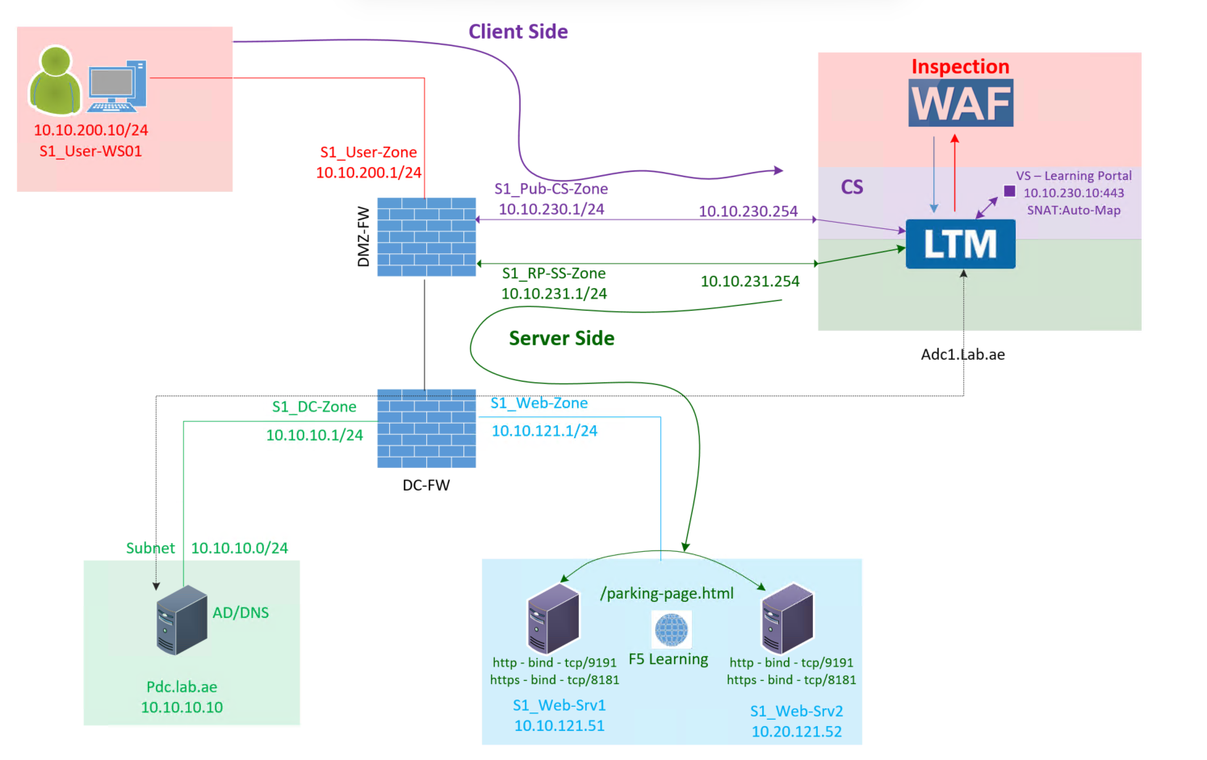
Step 8. DNS and NTP Configuration – Validation
Verify DNS and Network Routing
ip route get 10.10.10.10
Verify DNS resolution:
dig lab.ae
Verify NTP Synchronization
Check NTP peers and sync status:
ntpq -np
Verify system clock:
clock

Slide 14
Step 9. Understand Management Plane and Data Plane routing in F5.
F5 shares the same routing plane for both the Data Plane and the Management Plane.
What does this mean? It means that the F5 Data Plane and Management Plane are part of the same default VRF.
This is the reason why, when we configure the default route on the Management VLAN, it is configured with a higher metric. As long as the Data Plane is not configured, the system continue to use the Management default route for any outbound traffic.
The moment you configure a default route using the Data Plane, that route is installed with a lower metric.
Because of this lower metric, the Data Plane default route takes priority and becomes the active route, overriding the Management Plane default route.

Slide 15
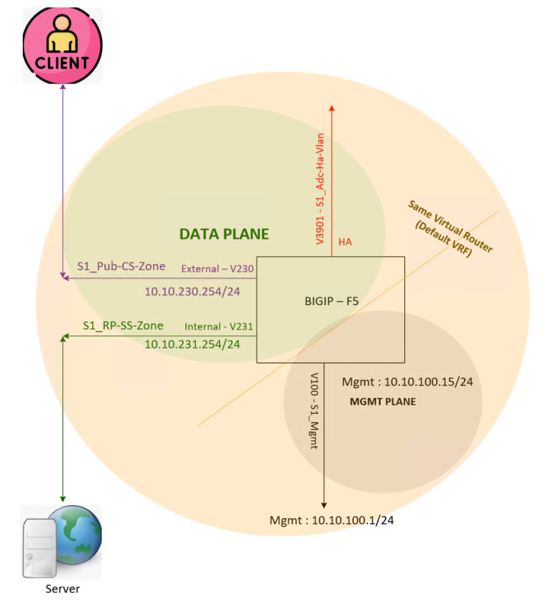
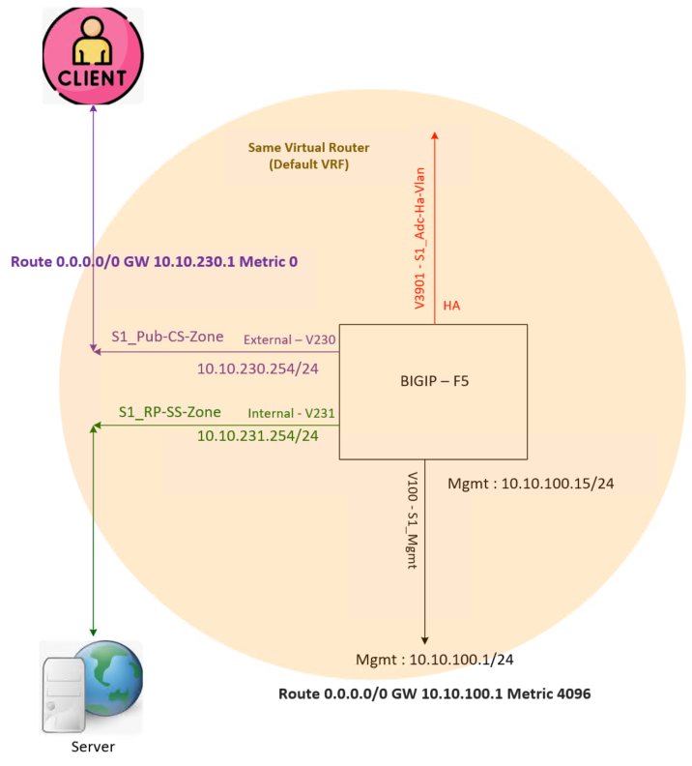
Step 9. Understand Management Plane and Data Plane routing in F5.

Slide 16
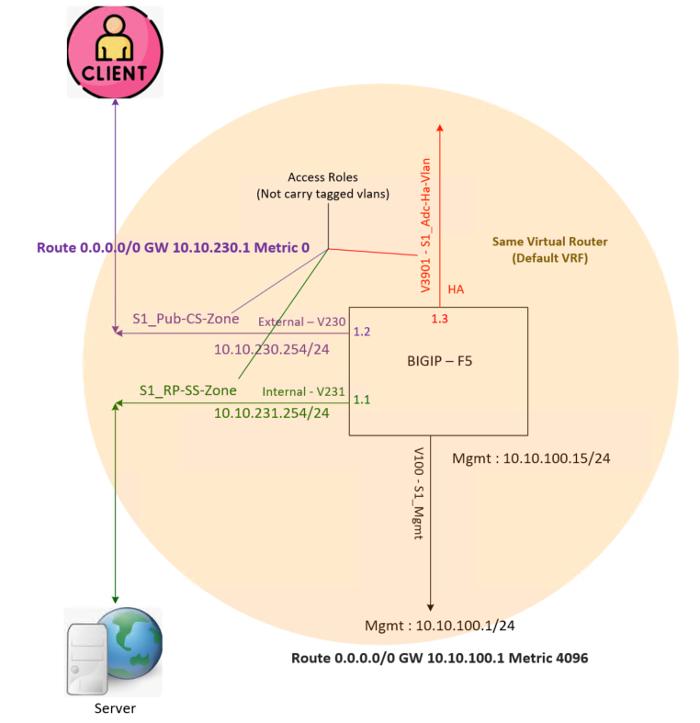
Step 10. Configure the Data Plane VLAN with the respective interfaces.
Identify the interfaces
Configure the vlans for Client-Side, Server-Side and High Availability
Client Side - S1_Pub-CS-Zone
Server Side - S1_RP-SS-Zone
High Availability - S1_Adc-Ha-Vlan
Configure the Self-IP for the Client-Side and Server-Side Vlans

Slide 17
Step 10. Configure the Data Plane VLAN with the respective interfaces.
Identify the interfaces
Configure the vlans for Client-Side, Server-Side and High Availability
Client Side - S1_Pub-CS-Zone
Server Side - S1_RP-SS-Zone
High Availability - S1_Adc-Ha-Vlan
Configure the Self-IP for the Client-Side and Server-Side Vlans

Slide 18
Step 10. This is a single F5 BIG-IP deployment; therefore, a floating IP is not required
(Verify the physical & Logical Connectivity)
We configured the server-side and client-side VLAN Self IPs to extend the Layer 2 logical connection to the gateway.
Let us test the Layer 3 logical connectivity from the F5 to both the client-side and server-side VLAN gateways.
In some cases, ping may be blocked. In such situations, you should check whether the gateway ARP entry is learned.
To check this, log in to F5 tmsh and run:
show net arp
This confirms that our VLAN configuration and Layer 3 logical connectivity between the F5 and the gateways are working correctly for both the server-side and client-side VLANs.
Important Note :- If this does not work, you should troubleshoot by checking the port group configuration.

Slide 19
Step 11. Configure the Data Plane routing.
Two types of Routing
Client-Side Routing
Server-Side Routing

Slide 20
Step 11. Configure the Data Plane routing – Client-Side Routing
Client-Side Routing – Default Route
0.0.0.0/0 to GW 10.10.230.1

Slide 21
Step 11. Configure the Data Plane routing – Server-Side Routing
Server-Side Routing
Most Specific Route to specific Destination Subnet
In Our Case it is 10.10.0.0/16

Slide 22
Step 12. Verify the Management Plane and Data Plane routing.
Two Default Routes
One from Management (Standby)
Another from Data Plane (Active)

Slide 23
Bonus Step. 1 - Does F5 need the client-side routing to communicate with clients?
👉 Great question!!!
The answer is NO - F5 does not need client-side routing to communicate with clients.
Why because?
The client always creates the connection to the F5.
Then F5 creates the separate connection to the server to serve this client request.
When the server replies, the F5 sends the response back using the same client connection.
If you notice it correctly - F5 never creates a new connection to the client.
Since - F5 does not initiate connections toward clients, it can return responses using Auto Last Hop.
So, a separate client-side route is not required. Meaning (You can remove Default Route) configured pointing to client-side interface Gateway.

Slide 24
Bons Step. 1 - Does F5 need the client-side routing to communicate with clients?
Important Note:
Auto Last Hop is a feature in F5.
By Default, Auto Last Hop is enabled on the VLAN-Interface and Virtual-Server.
If you disable this feature, then client-side route becomes mandatory.

Slide 25
Bonus Step. 2 – Then Why did we configure the Client-Side Default Route?
👉 Another Great question!!!
Without a client-side route, the F5 may use its management interface to reach external networks communication (for example f5.downloads and dynamic updates.)
This is not recommended because the management interface exposes:
Web access (HTTPS)
SSH access
This creates a security risk.
To avoid this, we configure a default route using the client-side VLAN Self IP, so all external traffic goes through the data plane instead of the management interface.
This makes the design more secure.

Slide 26
I hope this video helped implement the F5 VM as a Full Proxy. This concludes our Bonus Chapter 03. Thank you for watching!
Bonus Chapter 03 – How to implement F5 LTM as a full reverse proxy

